Slide 1

Classification Of Myocardial Infarction From Multi-lead ECG Signals Using Hybrid Deep Learning
19ECE499 Project Phase II
Group ID: ESI 10
ANCHURI CHETAN CHANDRA CB.EN.U4ECE19104
G A ROHIT CB.EN.U4ECE19115
SHARMILA S CB.EN.U4ECE19148
SOURABHI G S CB.EN.U4ECE19152
Guided by
Dr ANITA J.P

Slide 2
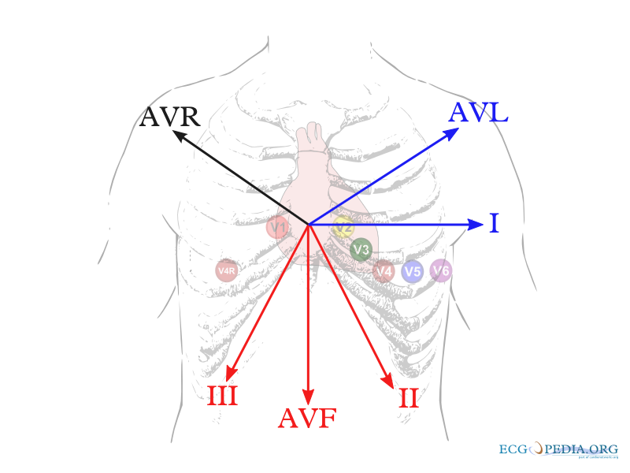
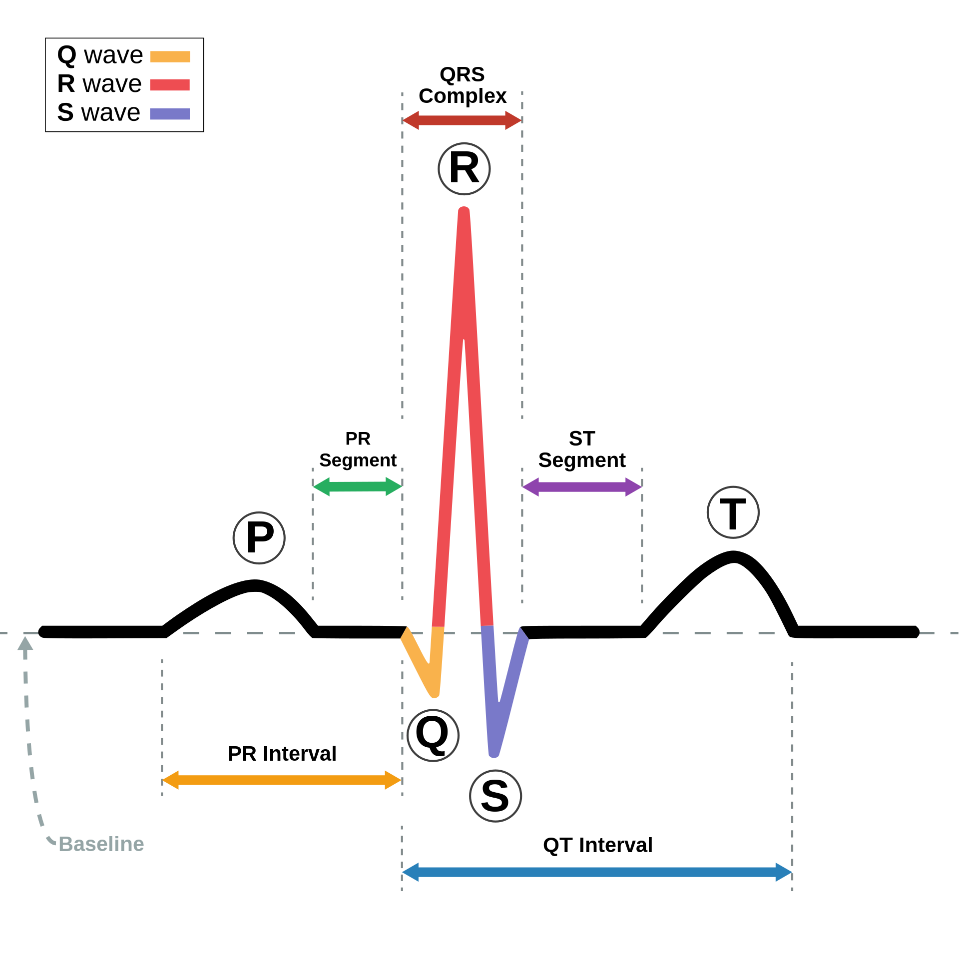
Introduction to the problem
Myocardial Infarction is a very serious heart condition.
Extracting features manually is time consuming.
Preprocessing the ECG signals is a complex the process.
To manage ECG data, preprocessing techniques requires specialized expertise and experience.
2

Slide 3
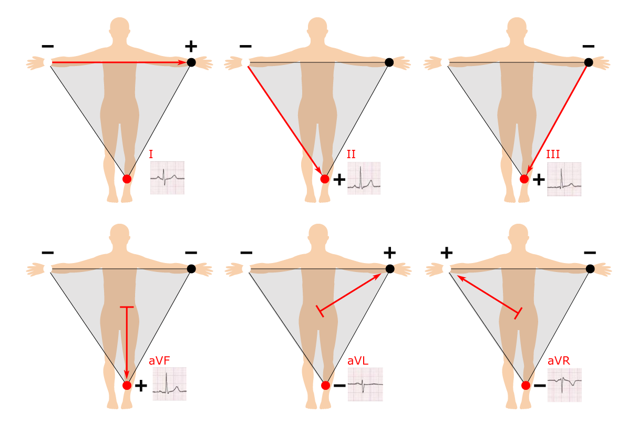
Motivation & Objectives
Detects occurrence of MI from ECG.
Locates 5 different locations of Heart.
Uses scalogram for CNN model input.
Compares ANN and various CNN models with our proposed model.
Our proposed work reduces complexity with CNN.
3

Slide 4
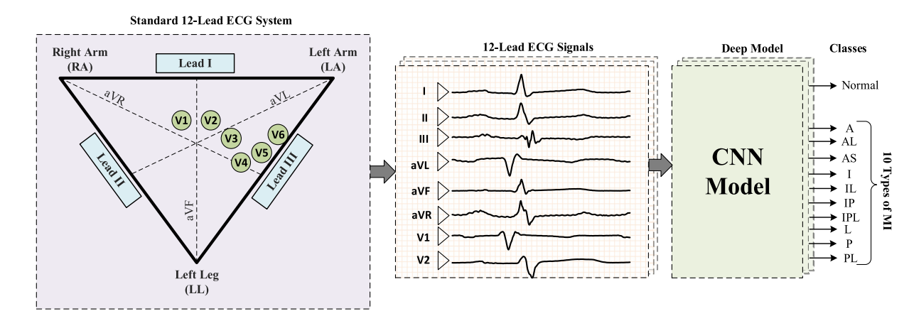
Literature survey
Requires various transforms to extracts P wave, QRS complex, T components.
Comparison Among Transform And Classifiers, shows CNN performs better.
Tuning AlexNet and GoogleNet for the specific work gives better results.
Multi-Lead Signal CNN is required for MI localization.
Scalogram is more popular in use for ECG signal classifications

Slide 5
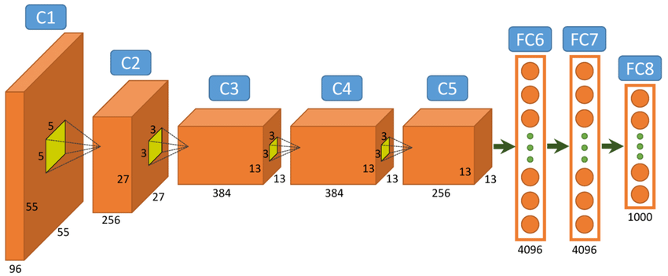

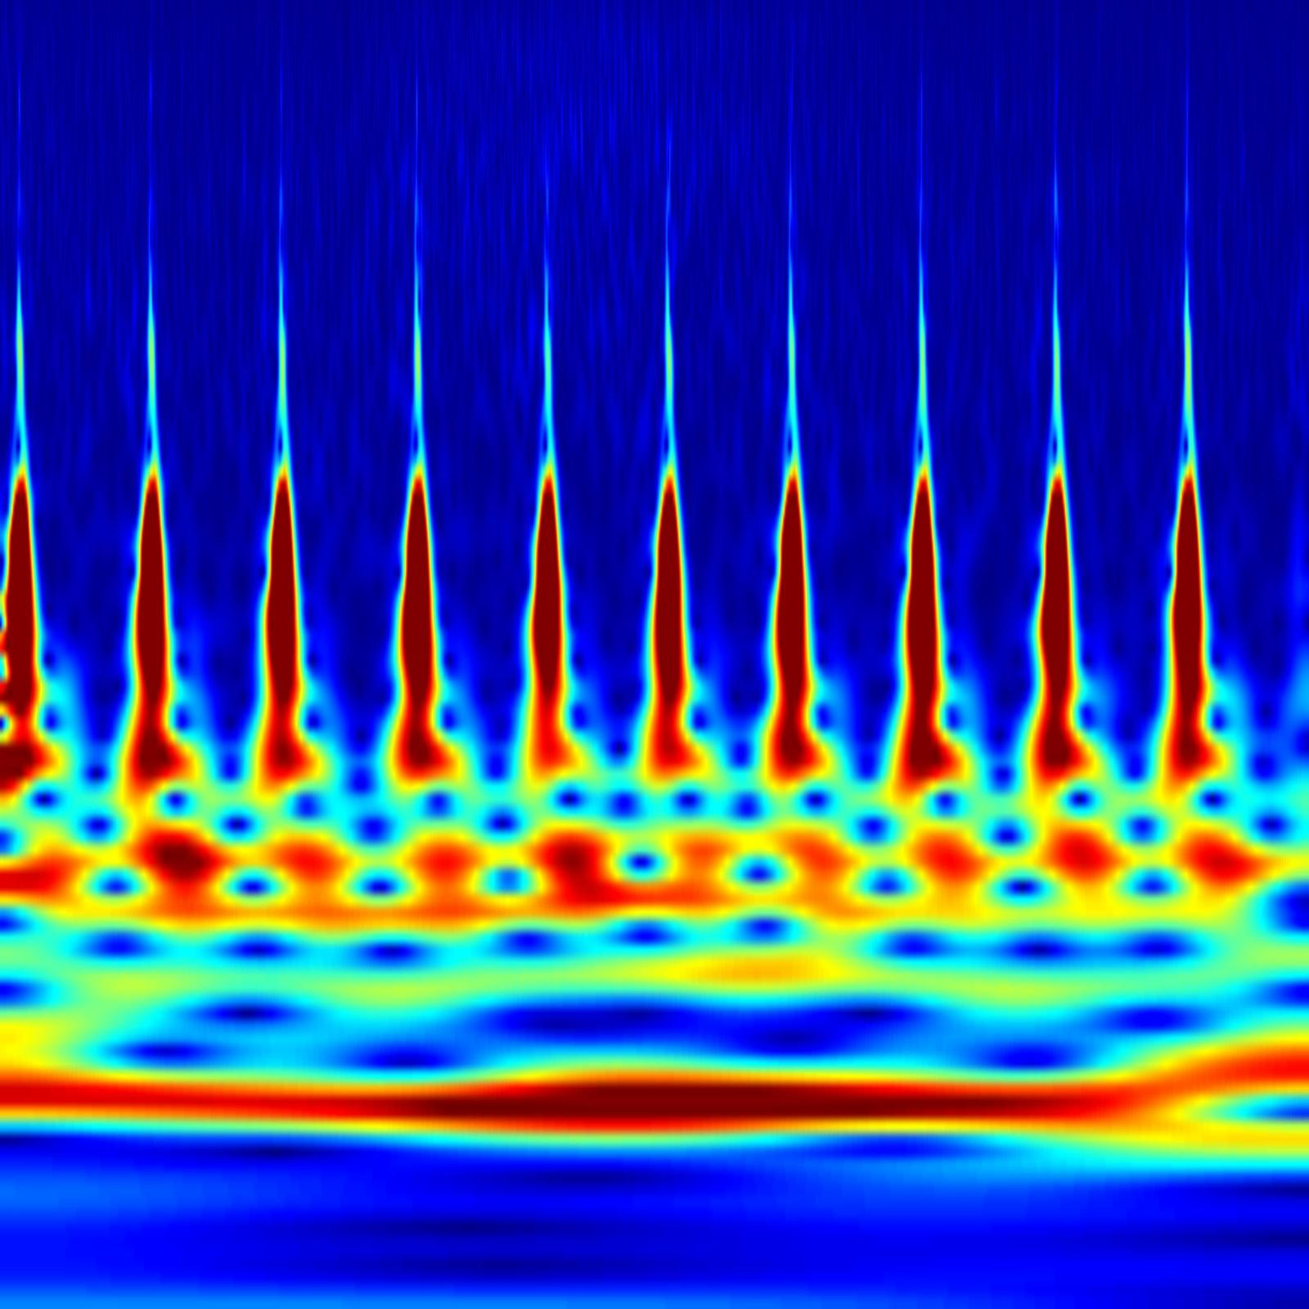
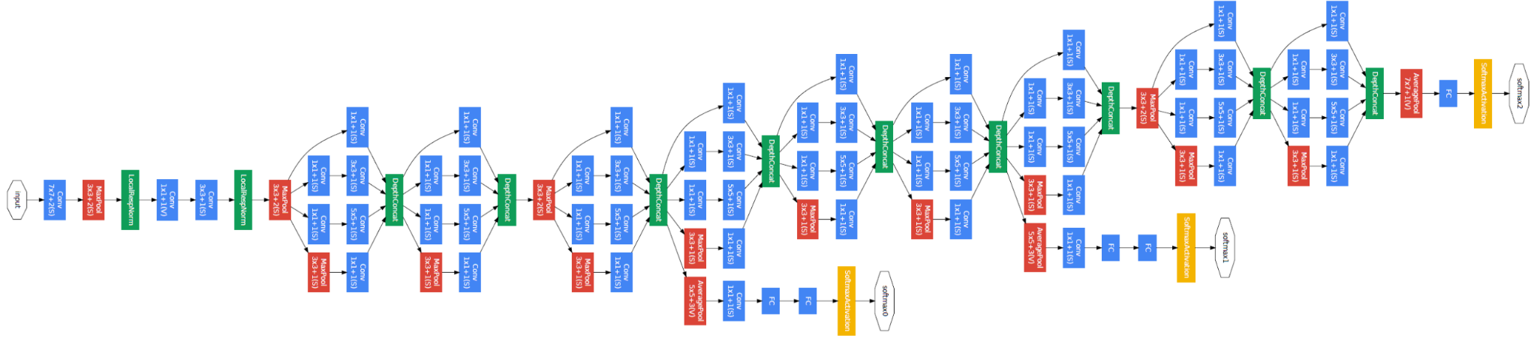
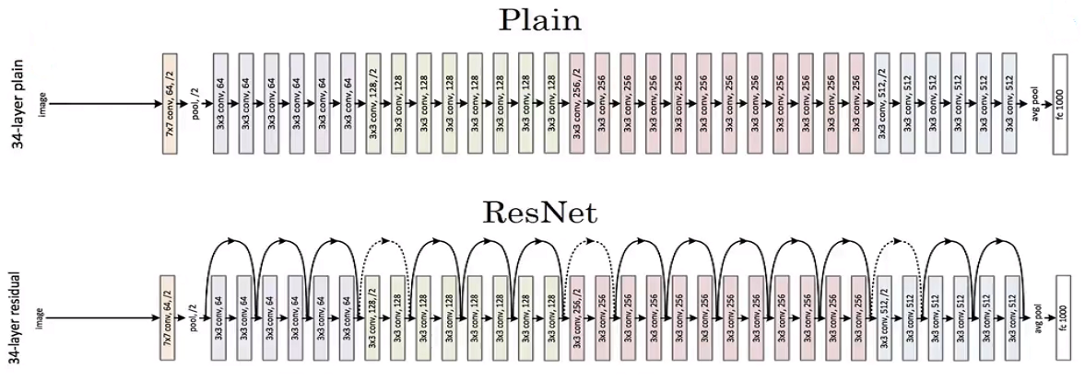

Detailed Proposed model
Compared 1 second, 2 seconds, 5 seconds scalogram samples.
Created automatic scalogram sorter for dataset.
Compared AlexNet, GoogleNet, ResNet to find optimal architecture.
AlexNet
GoogleNet
ECG SIGNAL PTB DATABASE
SCALOGRAM
ResNet
CNN ARCHITECTURES
NVIDIA GEFORCE GTX 1650, 8GB RAM, AMD RYZEN 5000 series
5

Slide 6



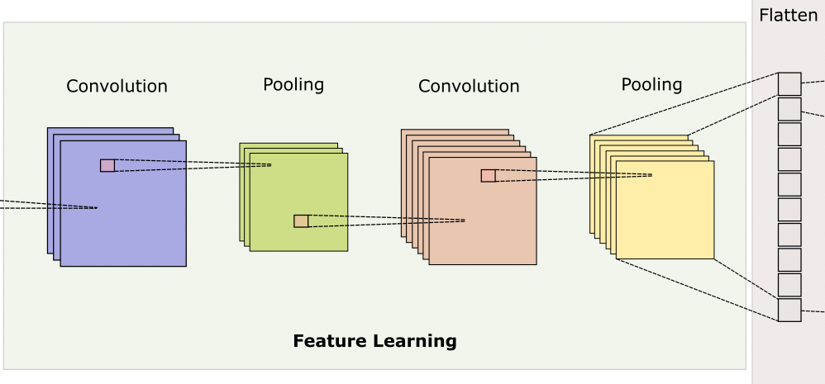
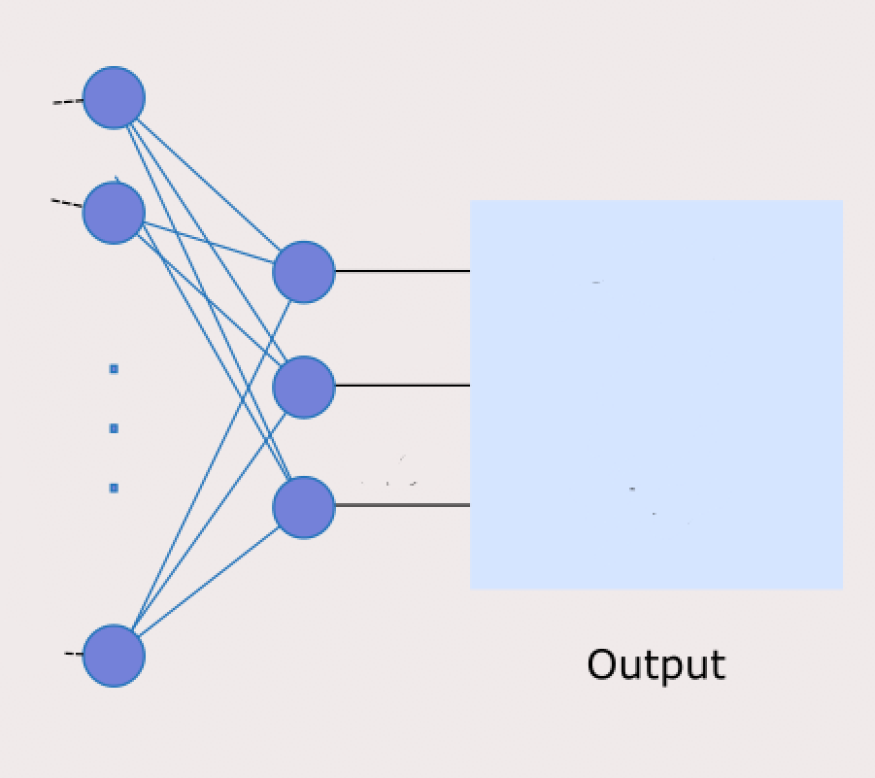
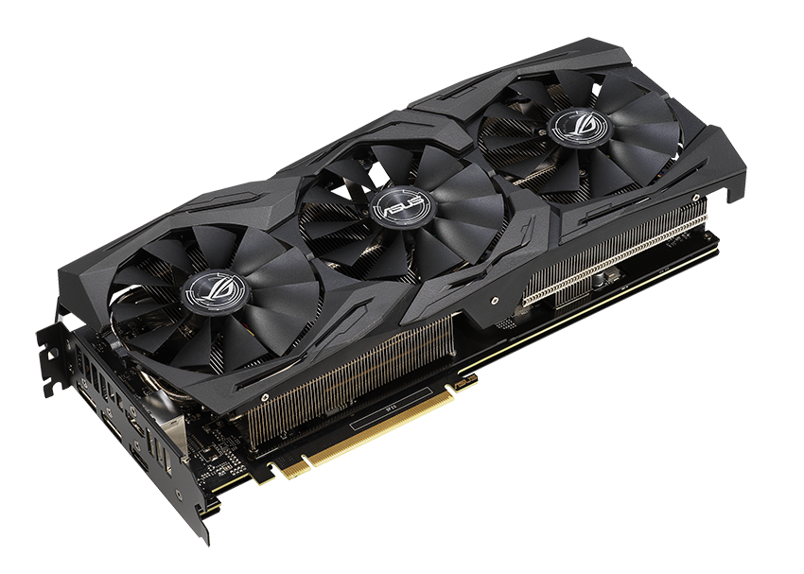
Detailed Proposed model
Modelized Ensemble of 12 experts for MI localization
Used GPU array for 12 parallel CNN computation
Custom training loop is implemented.
Tuned the hyperparameters for the model.
Inferior Lateral (IL)
Anterior (A)
Anterior Septal (AS)
Inferior (I)
Anterior Lateral (AL)
Healthy (H)
FEATURE EXTRACTION LAYERS
CUSTOM TRAINING LOOP
(TIME SYNCED) AND HYPERPARAMETER TUNING
LEAD FOLDERS WITH SCALOGRAMS
CONCATENATING FLATTENING LAYER
CLASSIFICATION LAYER
OUTPUT
NVIDIA GEFORCE GTX 2060, 16GB RAM, Intel i7 10th Gen
(USING GPU ARRAY)
May 13, 2023
6

Slide 7
Graphs, Tables, Results on proposed system
Architecture | Optimizer | Epoch | Validation | Testing | Duration
AlexNet 25 | SGDM | 20 | 99.66% | 99.32% | 1.9hrs
 | ADAM | 20 | 98.98% | 99.59% | 2.3hrs
 | RMSProp | 20 | 96.61% | 97.15% | 2.2hrs
Architecture | Optimizer | Epoch | Validation | Testing | Duration
GoogleNet 144 layer | SGDM | 20 | 98.31% | 99.32% | 2.7hrs
 | ADAM | 20 | 99.32% | 99.86% | 2.7hrs
 | RMSProp | 20 | 99.32% | 99.86% | 2.7hrs
Architecture | Optimizer | Epoch | Validation | Testing | Duration
ResNet 177 layers | SGDM | 10 | 96.27% | 97.70% | 4.2hrs
 | ADAM | 10 | 98.27% | 98.70% | 4.3hrs
 | RMSProp | 10 | 98.27% | 96.70% | 4.1hrs

Slide 8
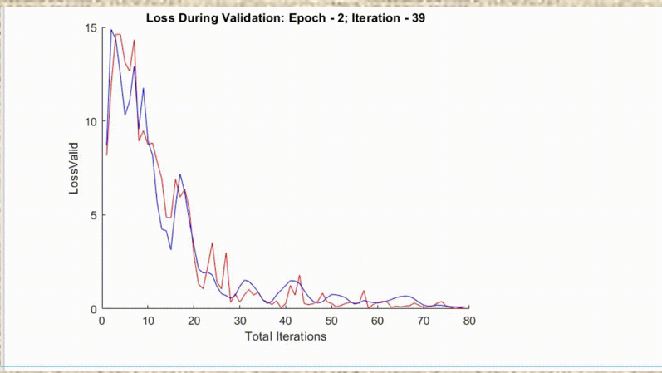
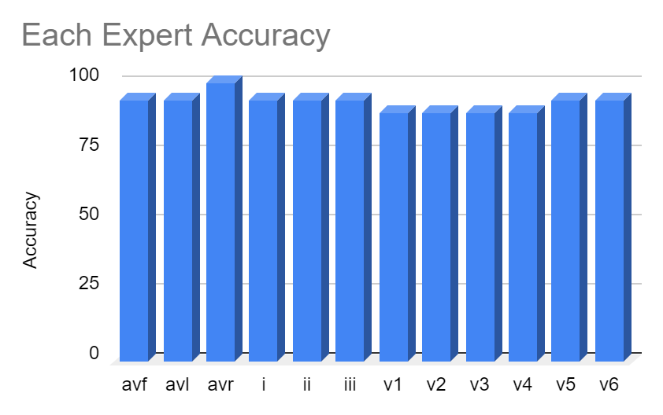
Graphs, Tables, Results on proposed system
Iteration | Initial Learning Rate | Batch Size | Dropout Rate | Accuracy
29 | 0.00015 | 12 | 0% | 98.78%
16 | 0.0003 | 12 | 0% | 86.70%
20 | 0.00143 | 14 | 0% | 90.00%
26 | 0.00295 | 10 | 15% | 61.67%
6 | 0.519 | 13 | 49% | 18.33%

Slide 9
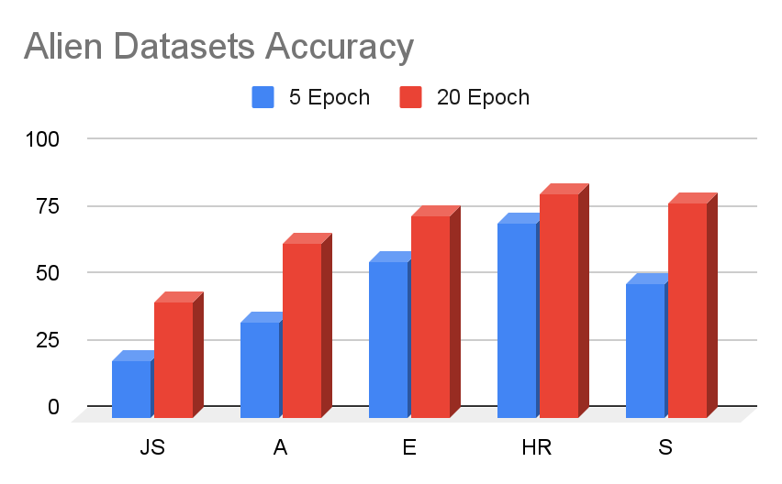
Graphs, Tables, Results on proposed system
TESTED WITH VARIOUS ALIEN DATASETS:
NAME |  |  | LABEL | SUBJECTS | FREQUENCY
Shaoxing and Ningbo Hospital ECG Database |  |  | JS | 45,152 | 500hz
PTB-XL electrocardiography Database |  |  | HR | 18885 | 500hz
PTB Diagnostic ECG Database |  |  | S | 545 | 1000hz
China Physiological Signal Challenge in 2018 |  |  | A | 664 | 500hz
Georgia 12-Lead ECG Challenge Database |  |  | E | 525 | 500hz

Slide 10
Result analysis and Inference
As it is noticed that the duration for ResNet is too high.
AlexNet performance is better among the three with its accuracy of 99.66% and lesser duration to obtain it.
GoogleNet with 100% is not preferred due to the overfitting conditions.
After tuning the hyperparameters, with a high accuracy rate of 98.78% is achieved.
Using the real time dataset, that is apart from PTB database, the proposed model gives a good accuracy of 83.3%.
Fast in learning since at 3rd epoch itself it gives highest accuracy rate over 98.78%.
Each leads accuracy on average is maintained at 98.7%

Slide 11
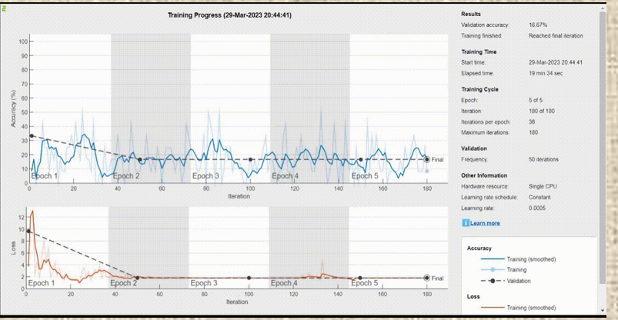


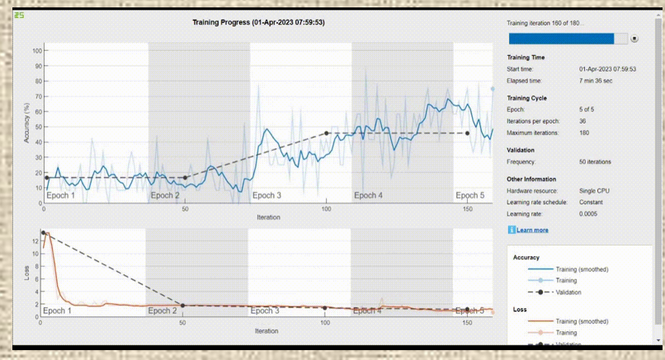
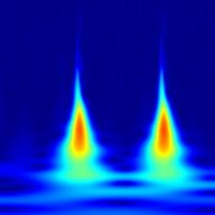
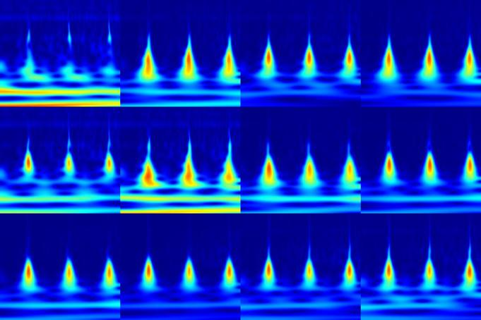
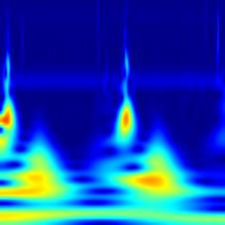
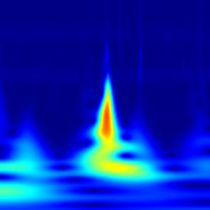
Comparison, Advantages & Disadvantages
ANN MODEL AND COLLAGE MODEL FOR MI LOCALIZATION:
12 LEAD SIGNAL
CONCATENATED INTO ONE SIGNAL
ANN MODEL
Accuracy 20.18%
(Noise in values)
SCALOGRAM
COLlAGE MODEL
CNN MODEL
Accuracy 60.43% (Slow in learning)

Slide 12
Comparison, Advantages & Disadvantages
Needed more GPU memory to train entire datasets to achieve more accuracy.
Accessing via Cloud GPU memory
From Matlab required licensing for Parallel cluster computation -
From Google Collab the time is limited to 12 hrs.
Solution:
Reduce the datasets and batch size
No dropouts since less datasets
No googlenet since less datasets couldn’t get train through nuge number of layers

Slide 13
Conclusion & Future Scope
Our model which has been trained with only 600 datasets per class yet with greater accuracy. Compared parallel CNN of 12 experts with collage and ANN and collage.
Future Scope:
Classify 6 more Localization which was having insufficient amount of datasets
Study on less influenceable ECG representation to noise, and get to know whether it will give less or more accuracy than direct ECG.
Train with Multiple Datasets and review the results.
Have excessive cloud computing processor for GoogleNet

Slide 14
References
[1] Arefnezhad, S.; Eichberger, A.; Frühwirth, M.; Kaufmann, C.; Moser, M.; Koglbauer, I.V. Driver Monitoring of Automated Vehicles by Classification of Driver Drowsiness Using a Deep Convolutional Neural Network Trained by Scalograms of ECG Signals. Energies 2022, 15, 480.
[2] Byeon, Y.-H.; Pan, S.-B.; Kwak, K.-C. Intelligent Deep Models Based on Scalograms of Electrocardiogram Signals for Biometrics. Sensors 2019, 19, 935.
[3] Olanrewaju, Rashidah & Ibrahim, S. & Asnawi, Ani Liza & Altaf, Hunain. . “Classification of ECG signals for detection of arrhythmia and congestive heart failure based on continuous wavelet transform and deep neural networks,” Indonesian Journal of Electrical Engineering and Computer Science, Vol. 22, No. 3, pp. 1520~1528, June 2021.
[4] Uchiyama, R.; Okada, Y.; Kakizaki, R.; Tomioka, S. End-to-End Convolutional Neural Network Model to Detect and Localize Myocardial Infarction Using 12-Lead ECG Images without Preprocessing. Bioengineering 2022, 9, 430.
[5] Ulas Baran Baloglu, Muhammed Talo, Ozal Yildirim, Ru San Tan, U Rajendra Acharya, “Classification of myocardial infarction with multi-lead ECG signals and deep CNN,” Pattern Recognition Letters, Volume 122, pp. 23-30, 2019.

